Slide 1
Online Private Tutor System
Group members:
CAGUIAT, RONALIE T.
CAJUCOM, RYAN CHRISTIAN G.
GUZMAN, ROEL G.
PIOQUINTO, RUSTOM D.

Slide 2
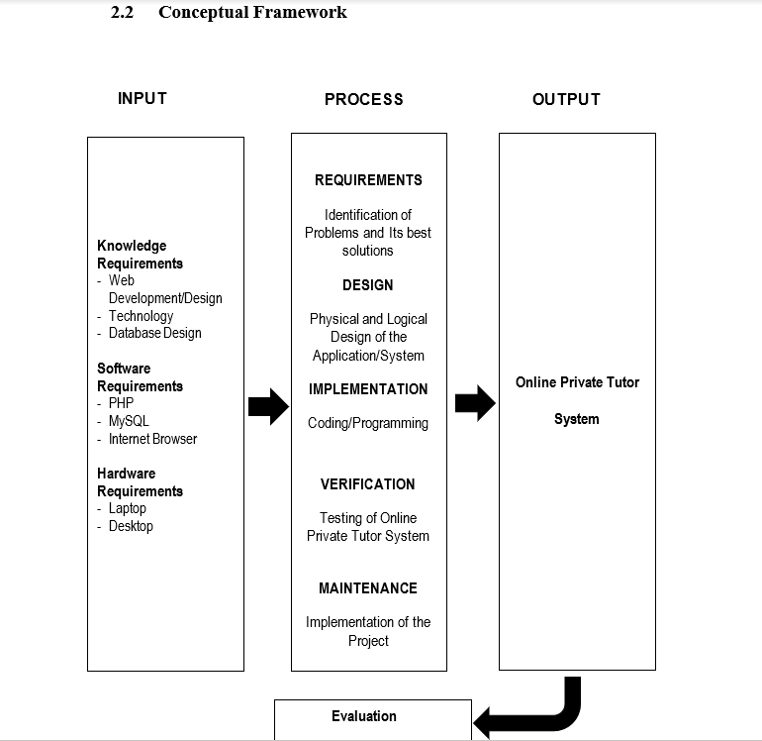
COMMENTS FROM THE PANEL:
1. Include the type of software evaluation mechanism that you will do in the conceptual framework

Slide 3
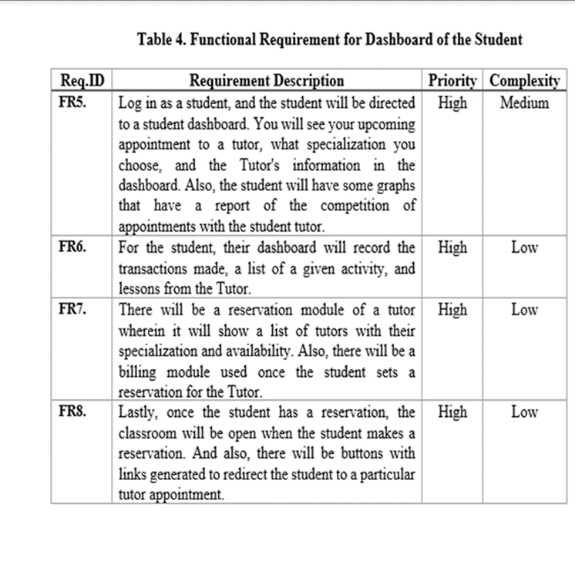
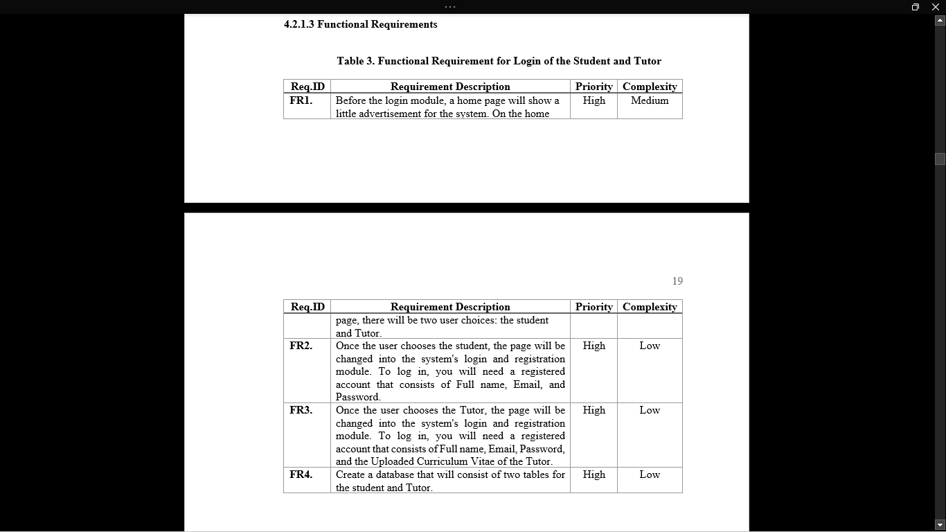
COMMENTS FROM THE PANEL:
2 . Include all modules in the FRs. You only included the login. Indicate also the payment mechanism.

Slide 4


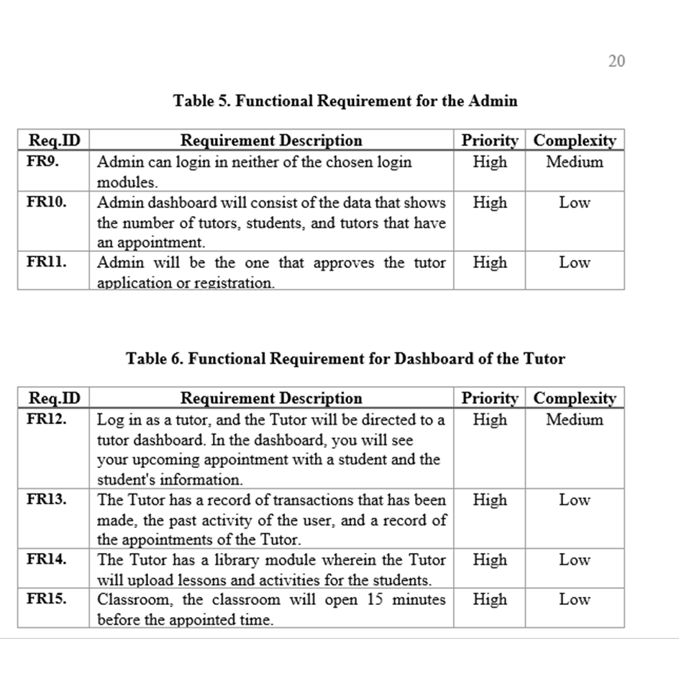
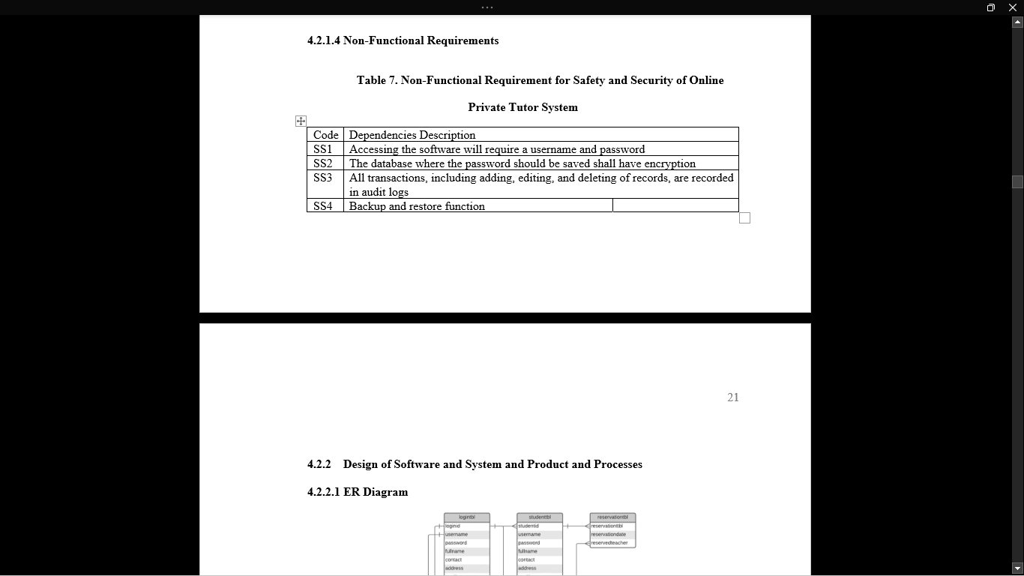




Slide 5
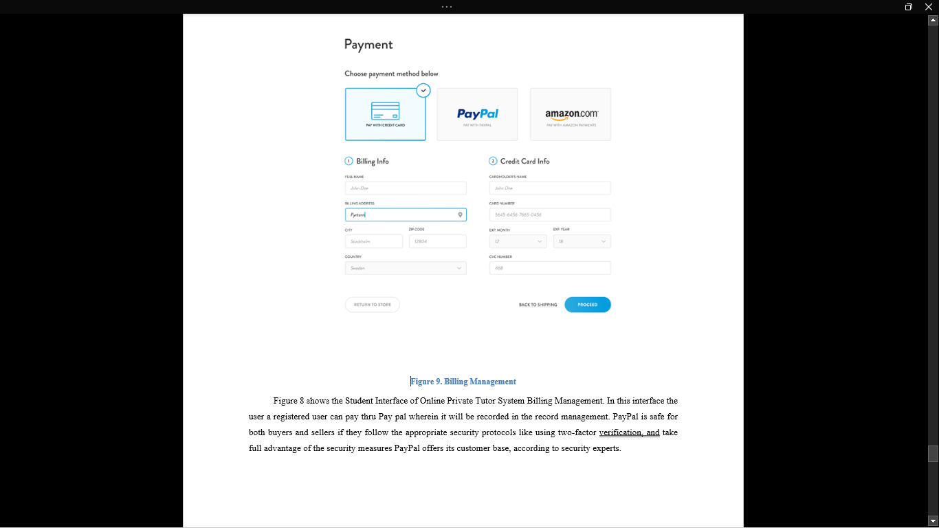
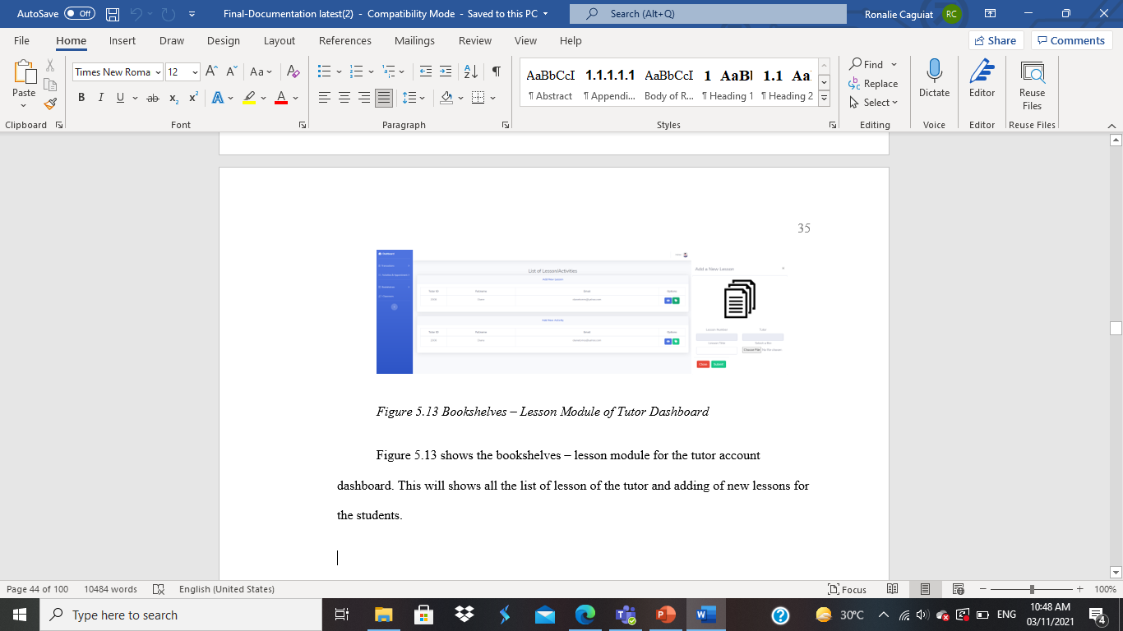
COMMENTS FROM THE PANEL: 3. Where’s the library? Where’s is the billing?

Slide 6
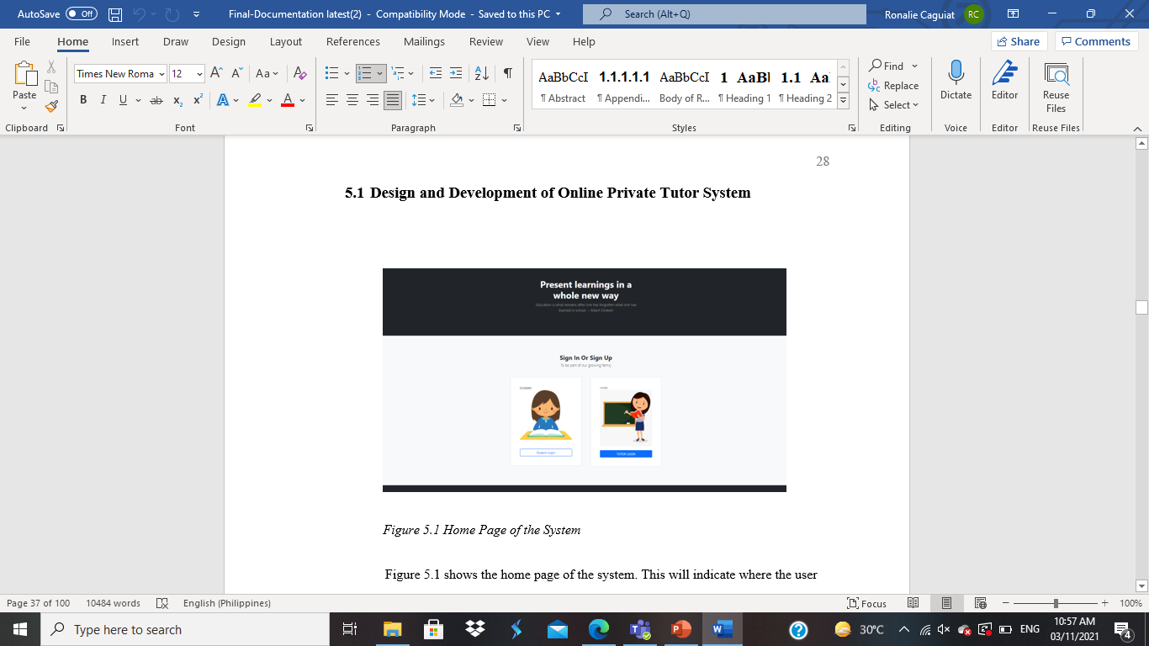
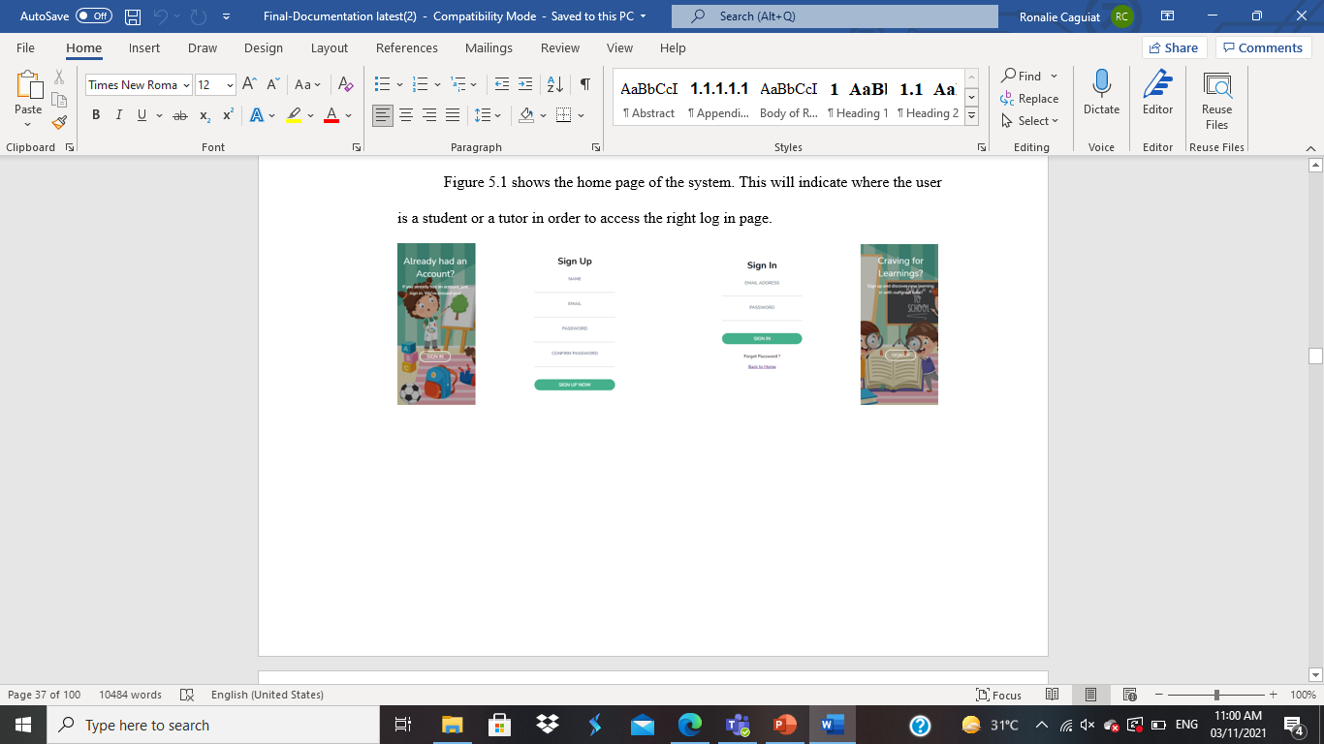
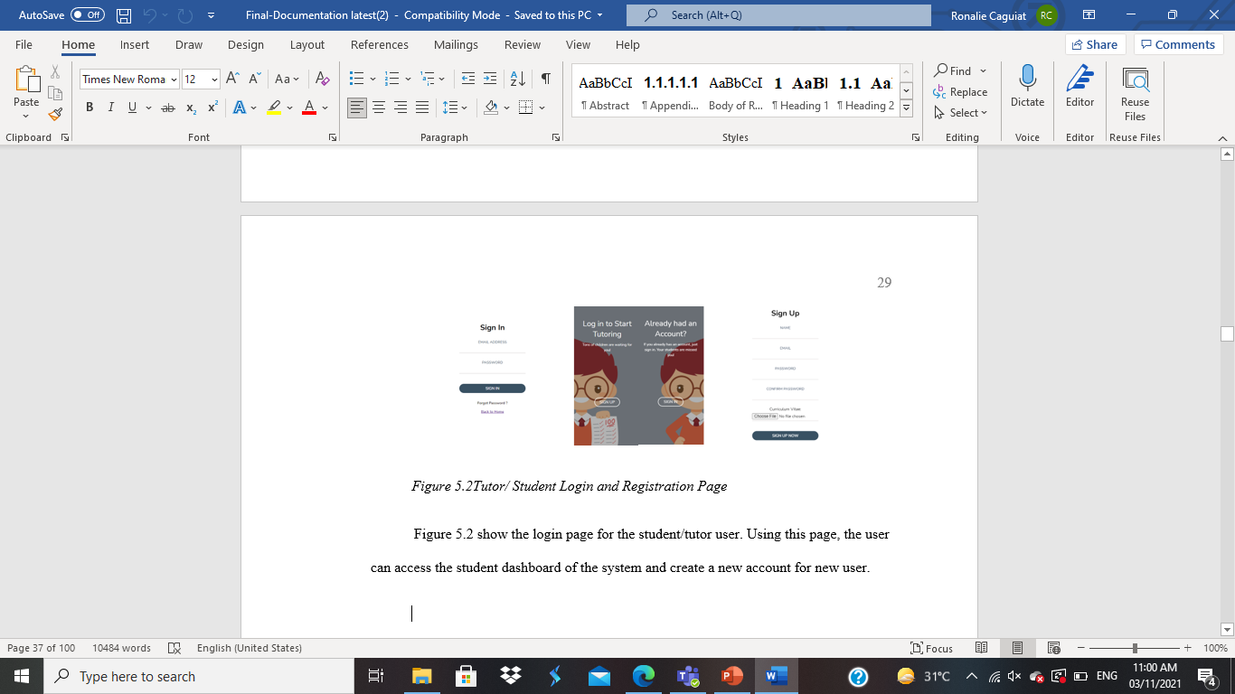
Objectives 1: To develop a Web Page or a system with comprehensive features such as;
1.1. Login/Registration Module 1.1.1 Tutor and Student Registration

Slide 7
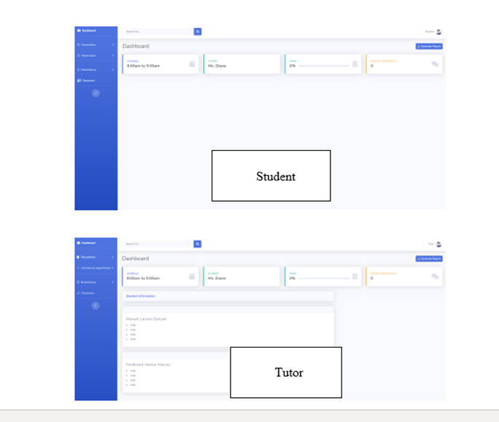
1.2. Dashboard User/Tutor

Slide 8
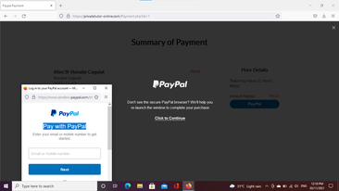
1.3.1. Payment Transactions

Slide 9
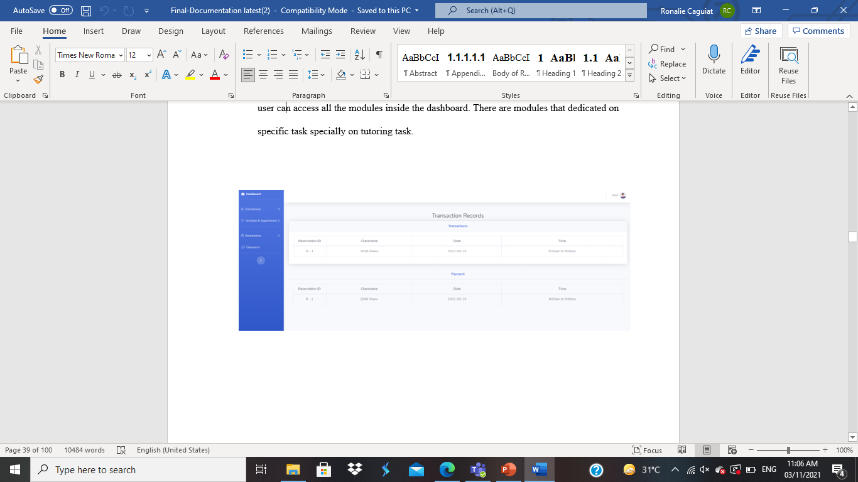
1.3 Record Management:
1.3.2. Reservation Transactions

Slide 10
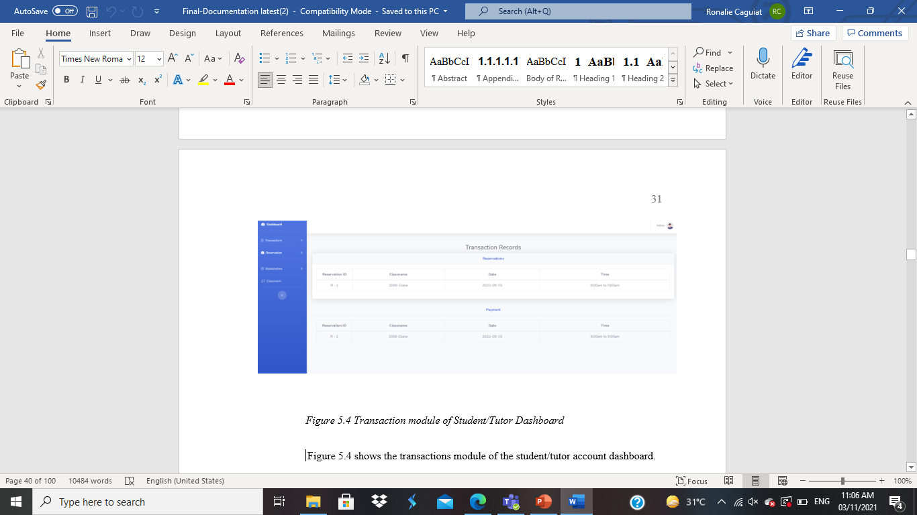
1.4 Reservation Module

Slide 11
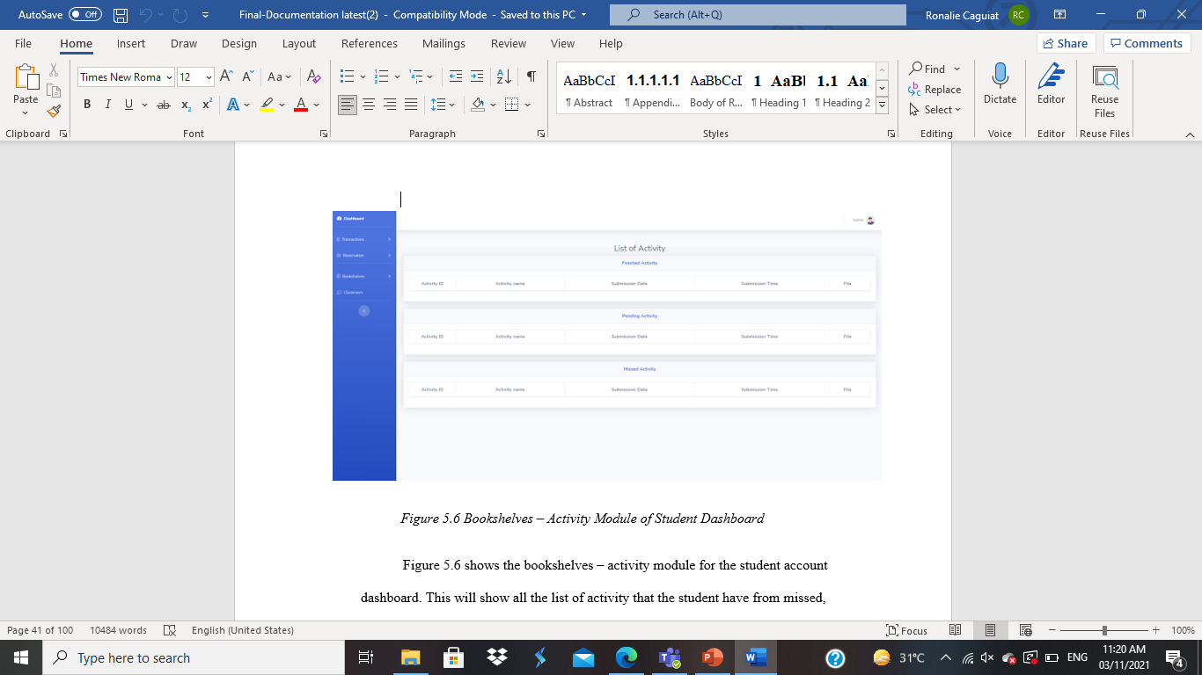
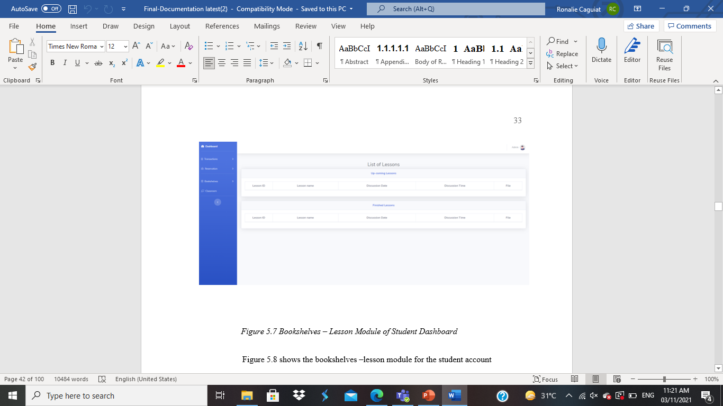
1.5. Library Management
1.5.1. Activity List

Slide 12
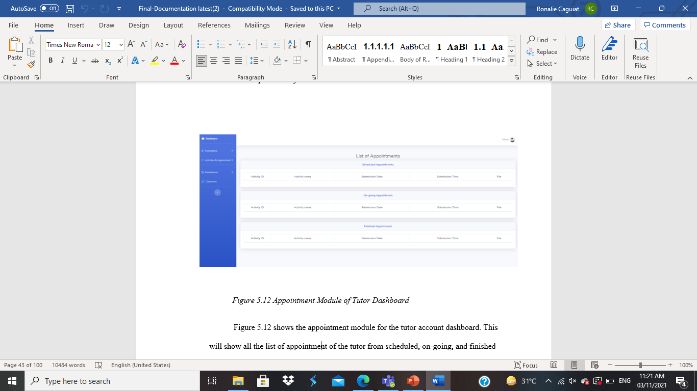
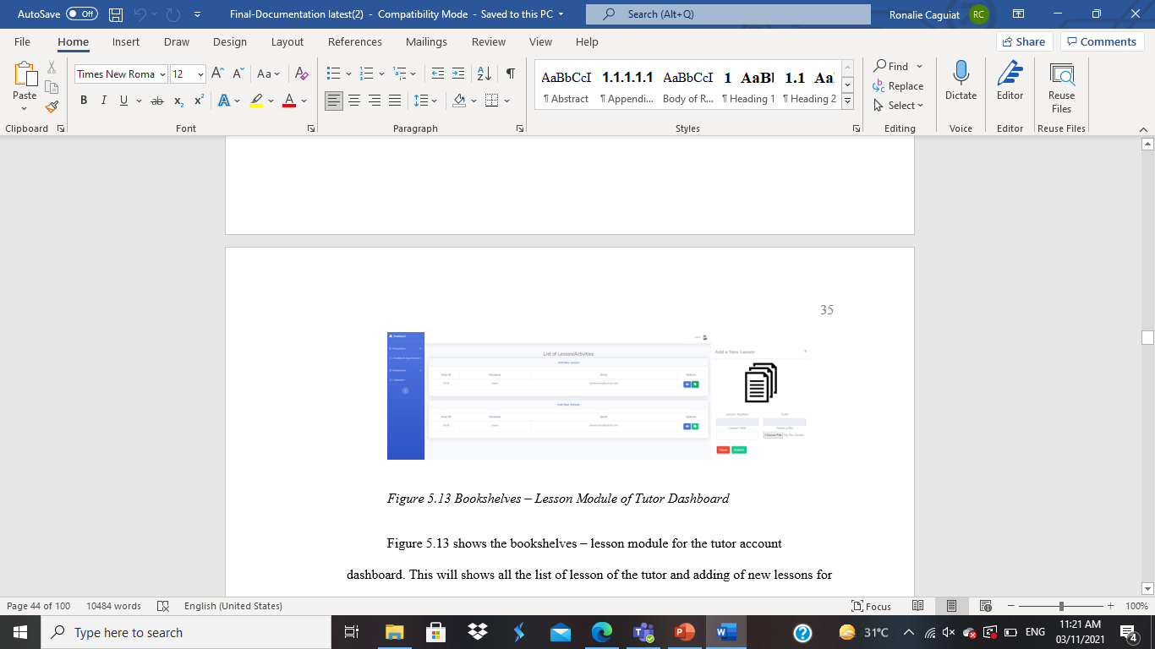
1.5.2. Lesson List

Slide 13
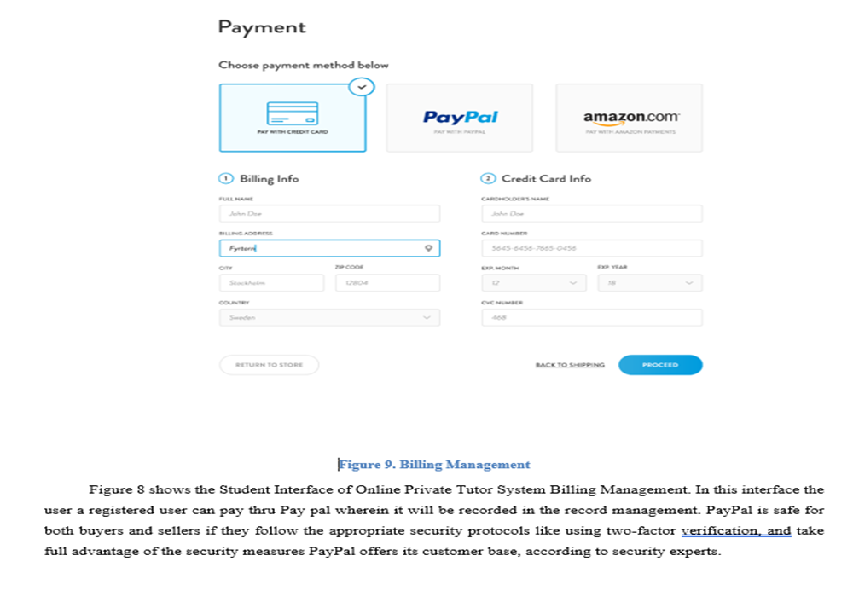
1.6. Billing Management
6.1. Paypal

Slide 14
OBJECTIVES 2.
To provide an easy-access system that students and tutors can use for their transactions and needs.
OBJECTIVES 3.
To evaluate and improve the proposed system using the characteristics of ISO/IEC 25010:2011.

Slide 15
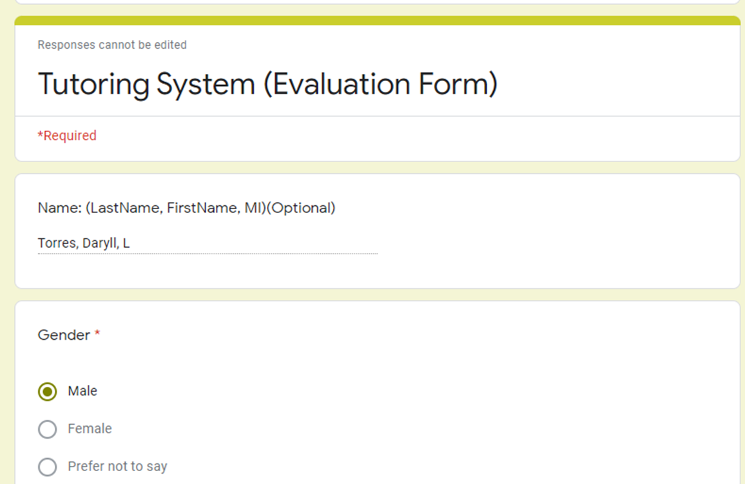
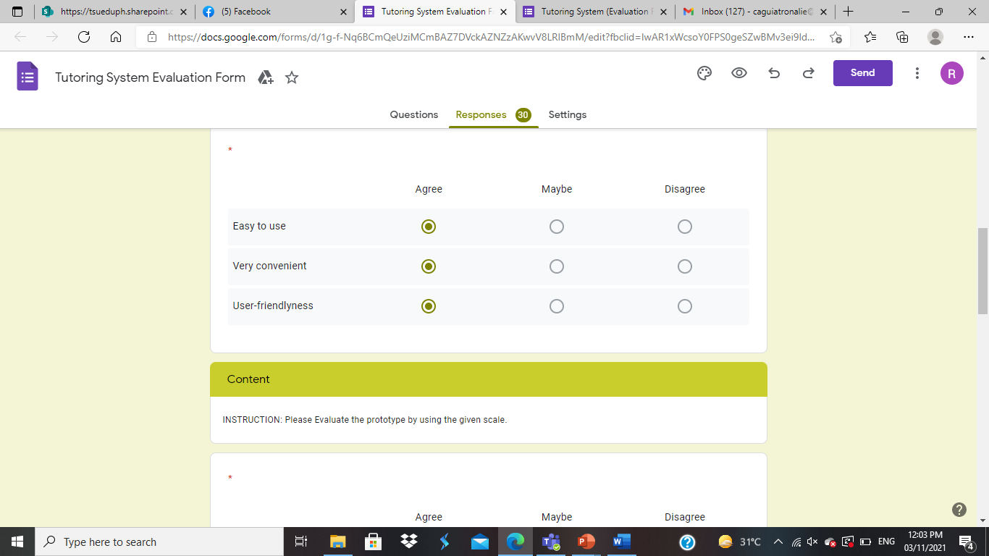
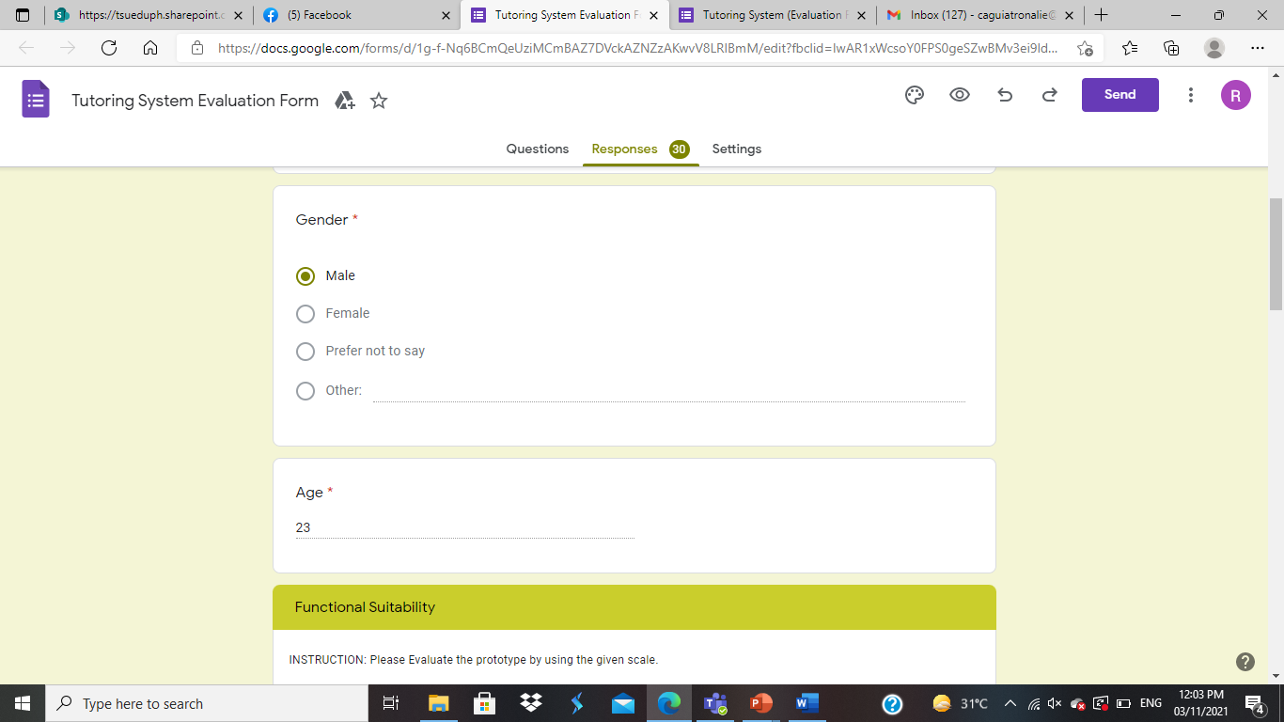

Slide 16
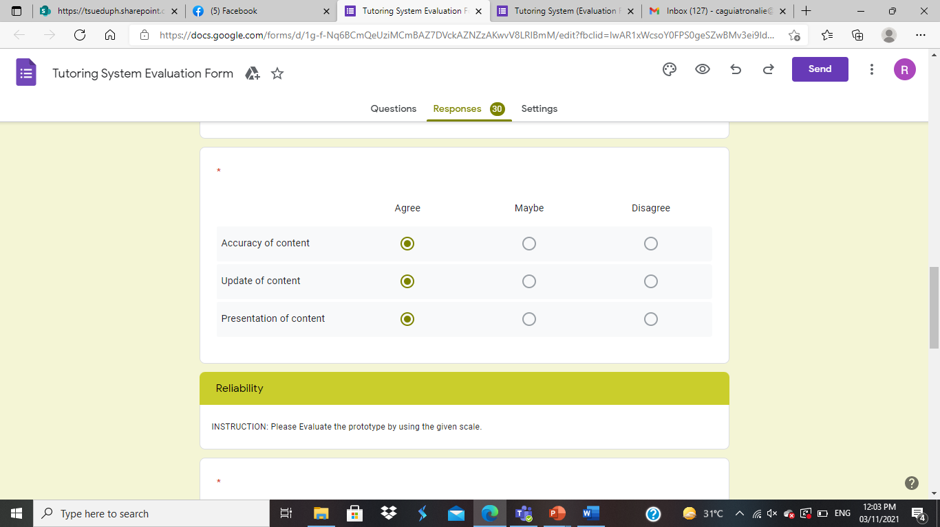
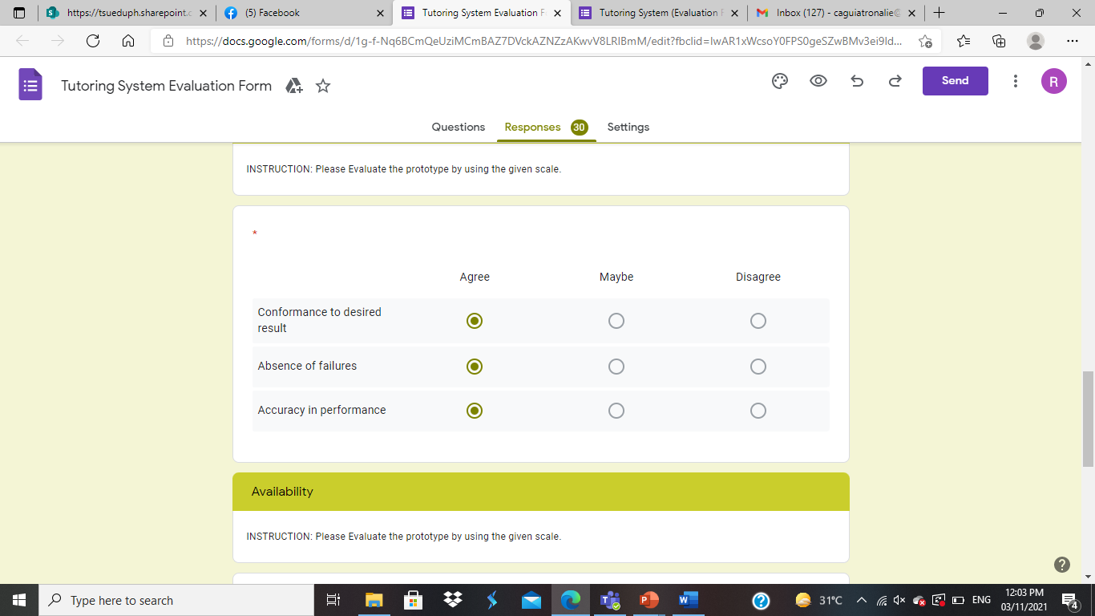

Slide 17
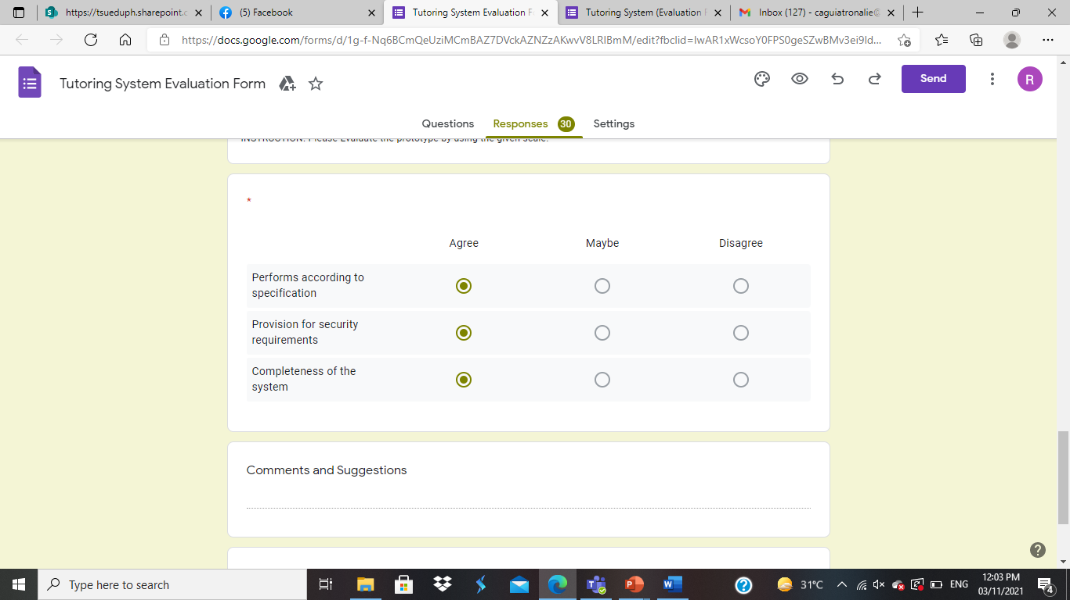
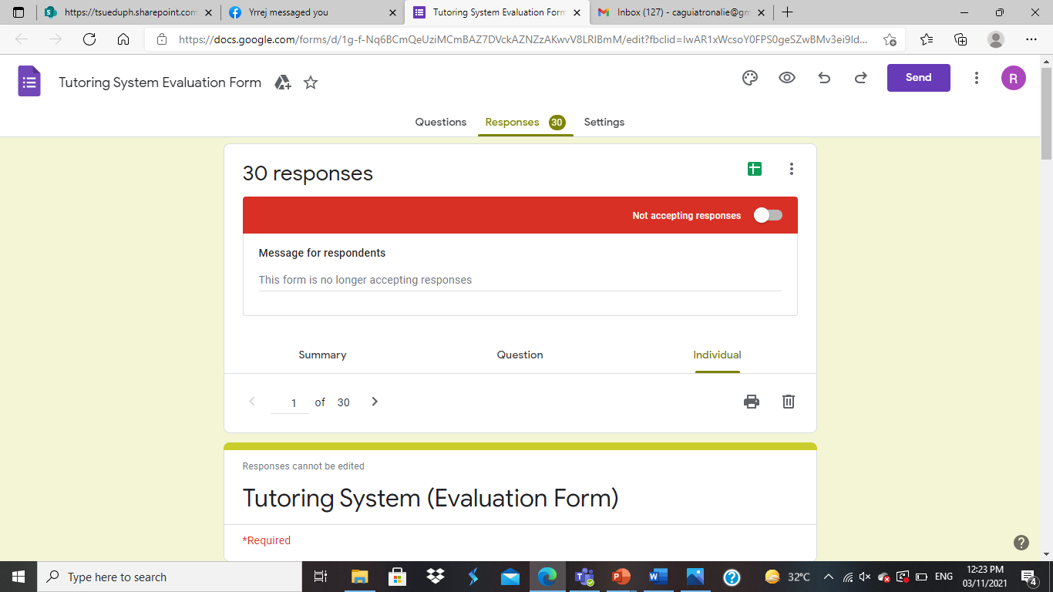

Slide 18
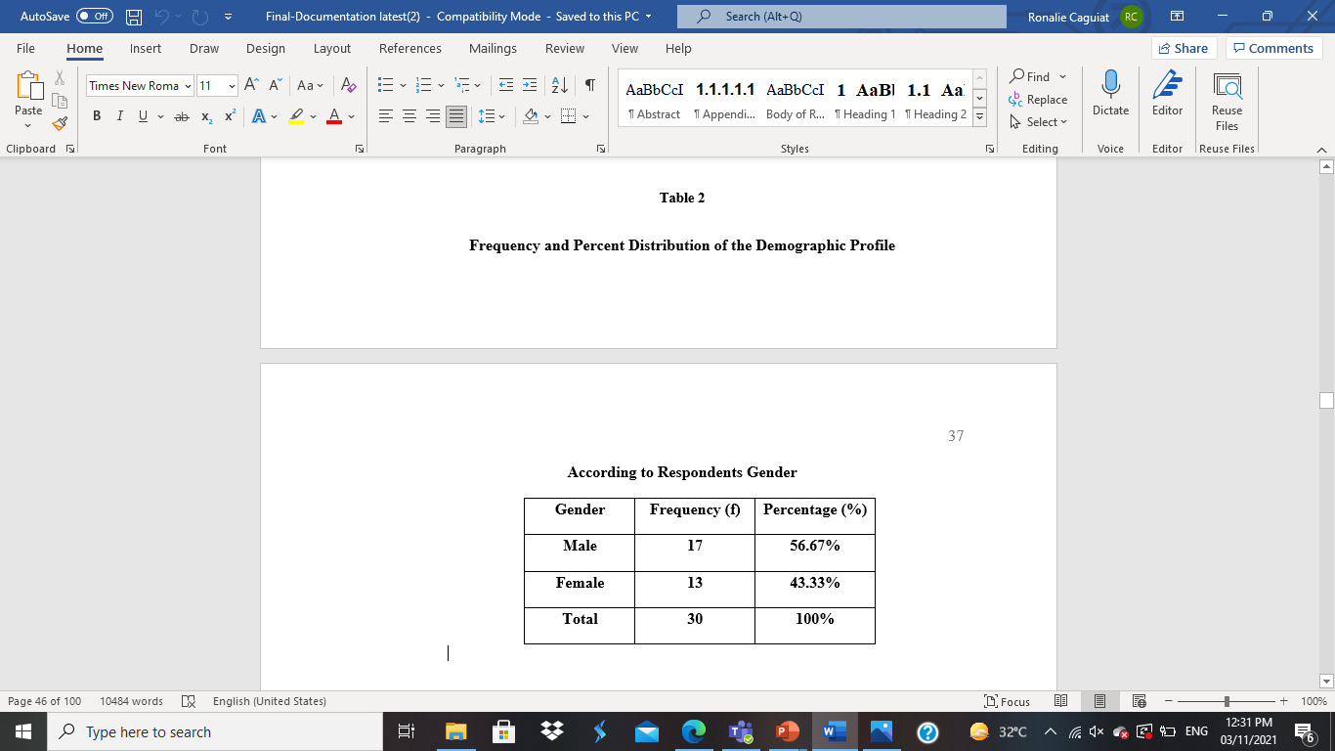
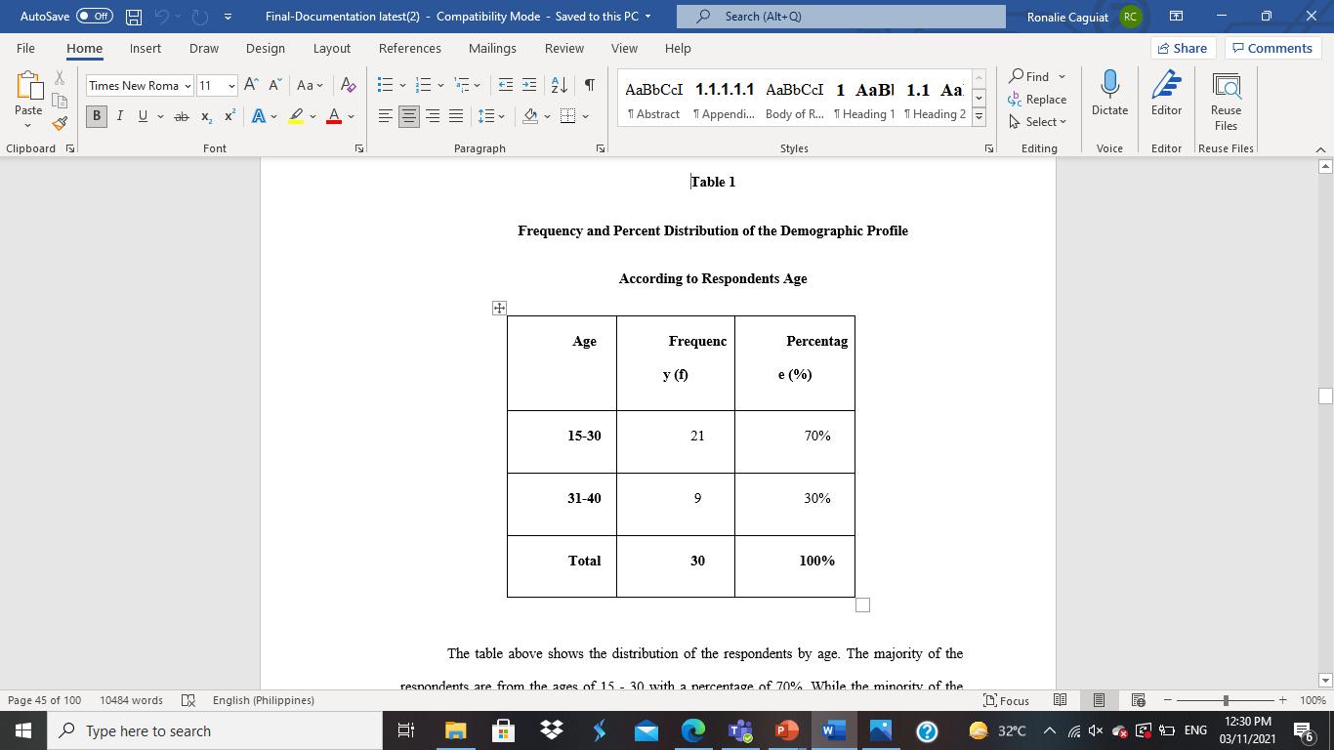

Slide 19
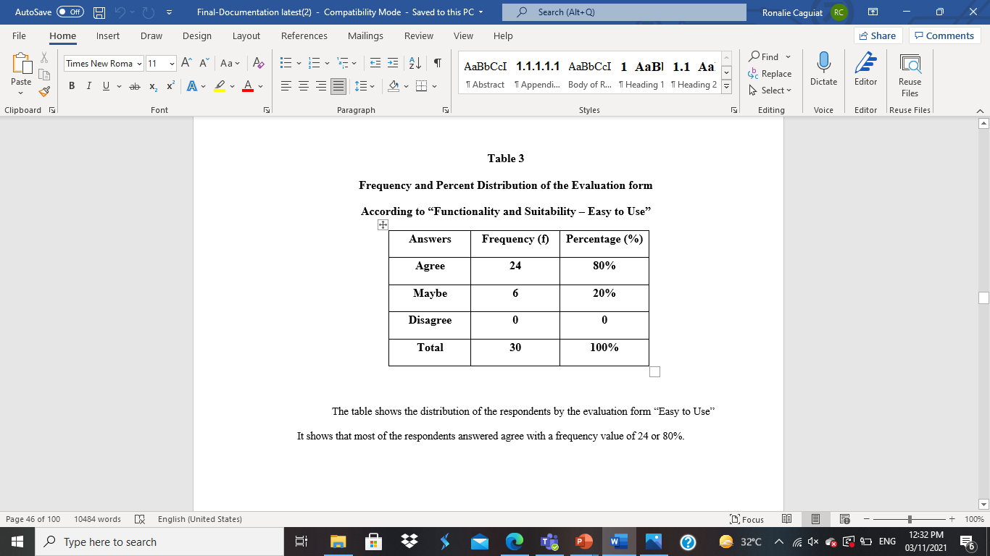


Slide 20

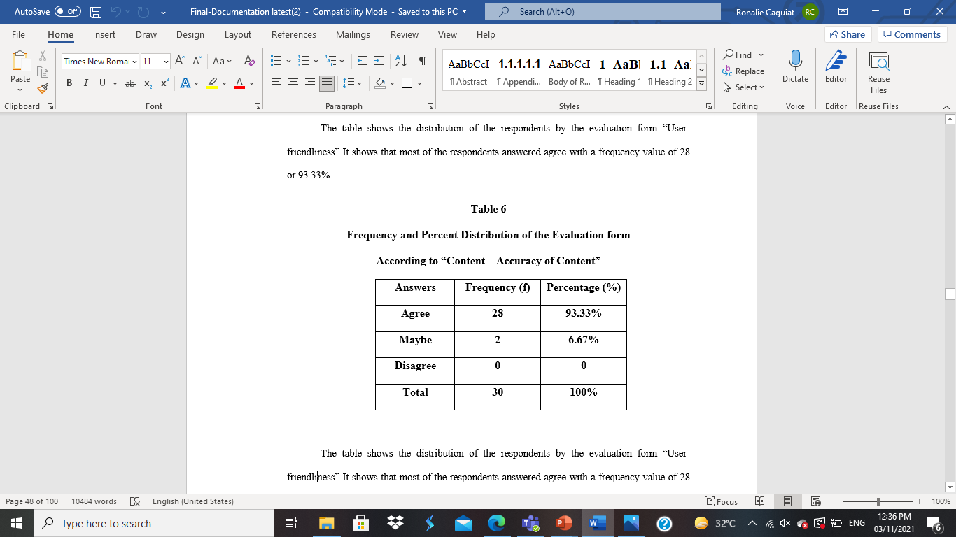

Slide 21
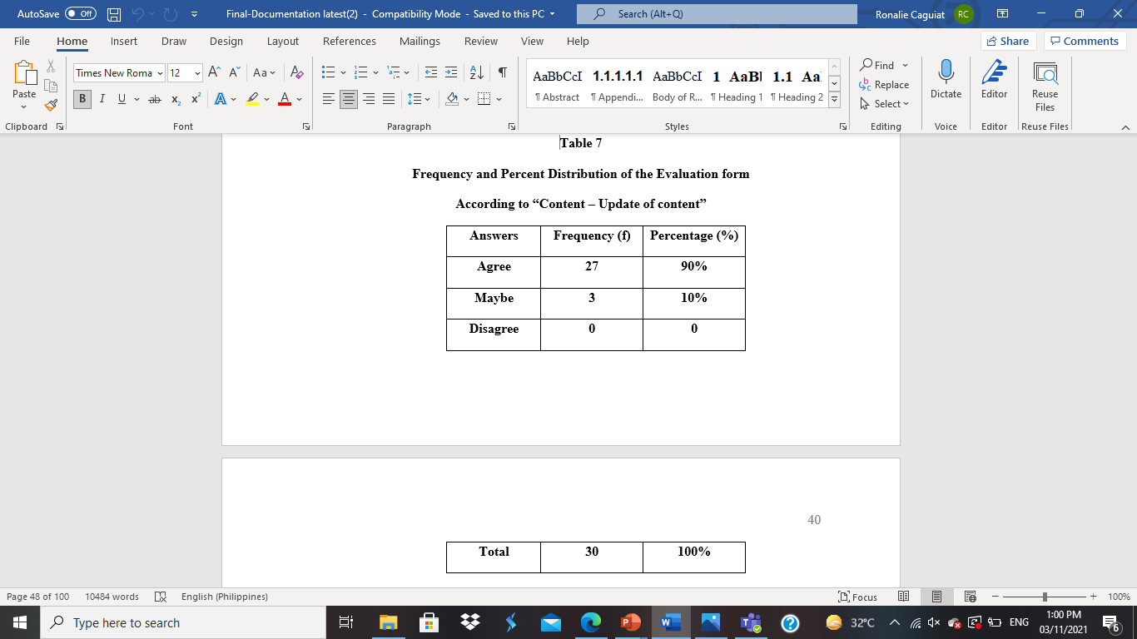
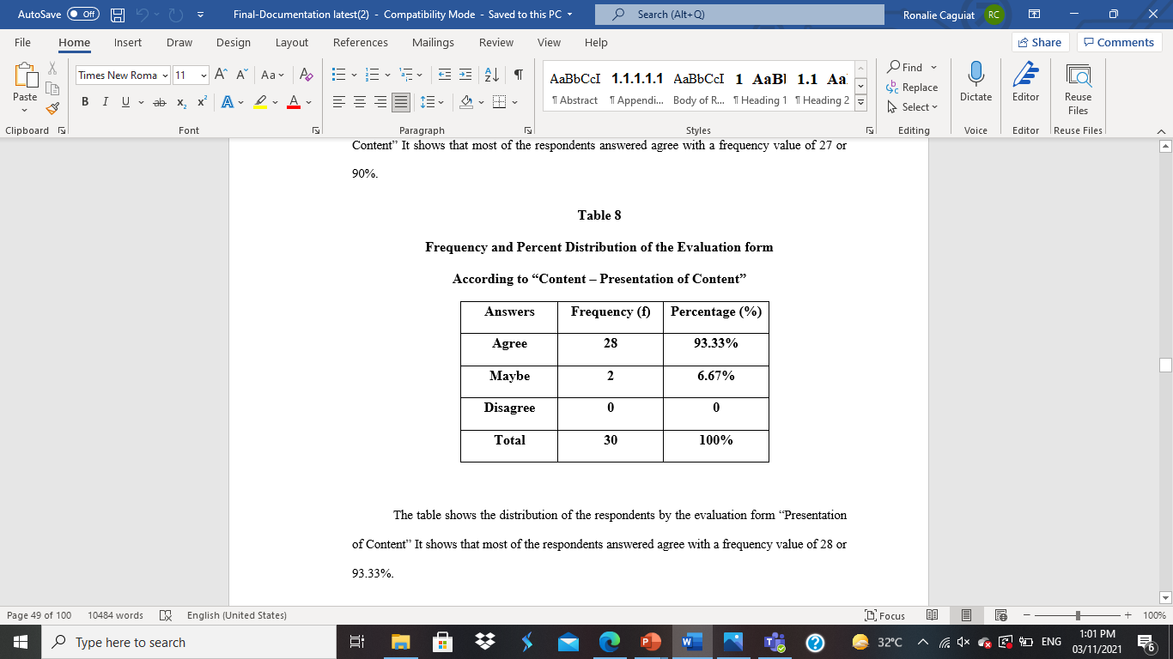

Slide 22
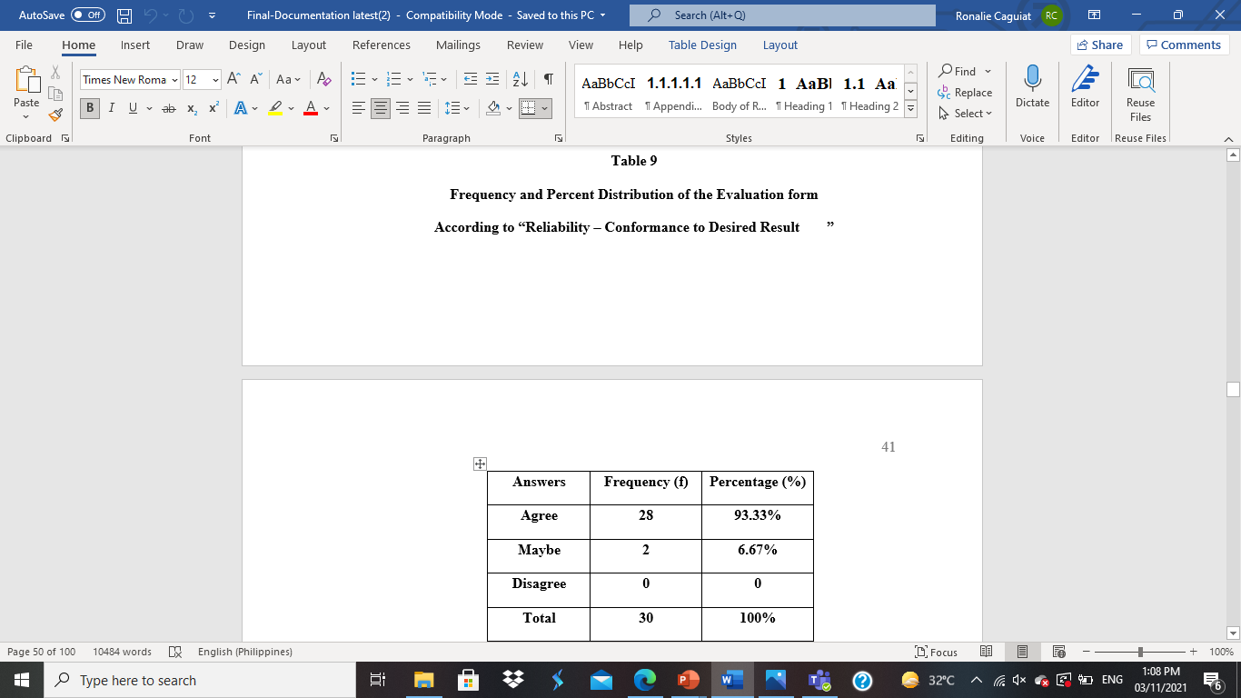


Slide 23
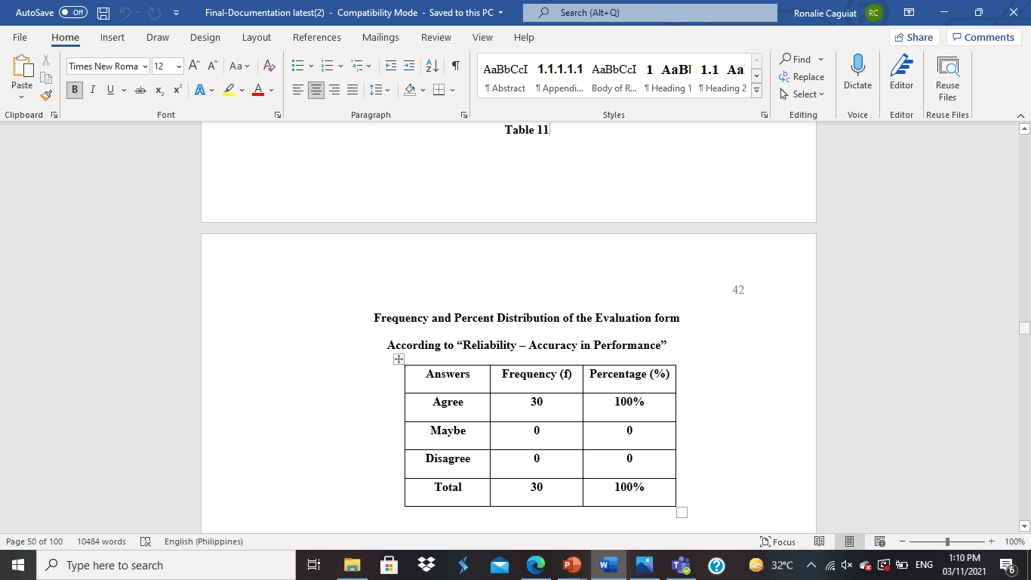


Slide 24



Slide 25
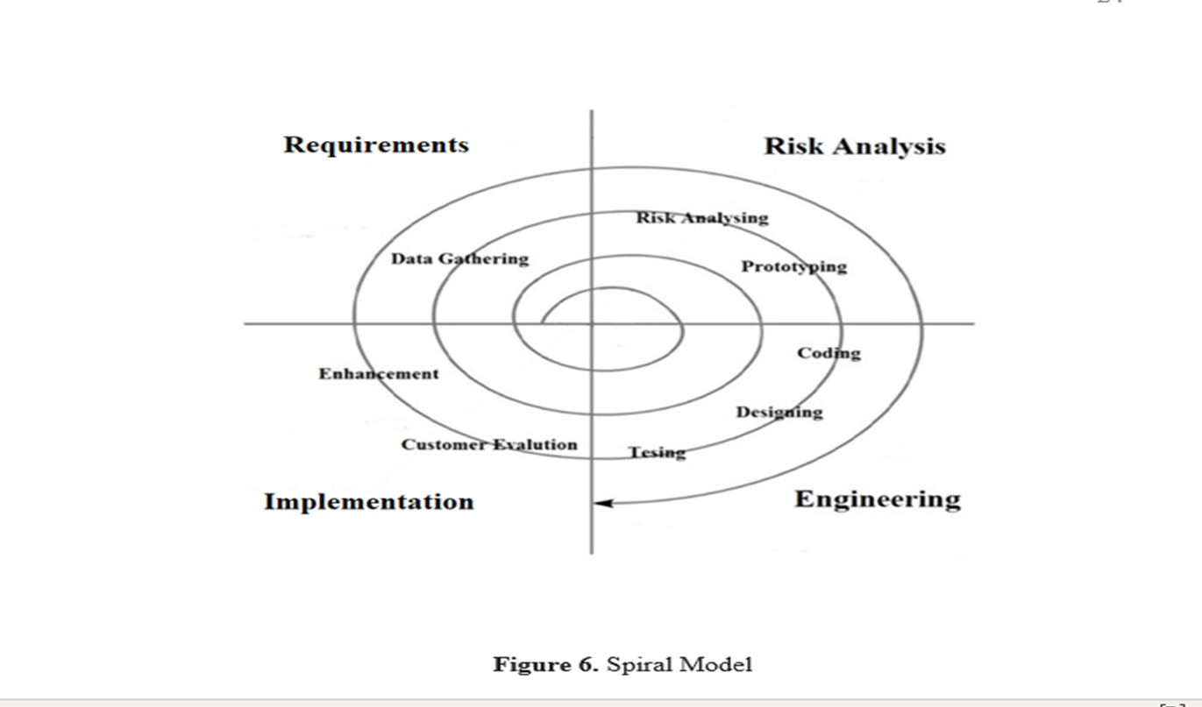

Slide 26
CONCLUSIONS AND RECOMMENDATIONS Conclusions:
Based on the results and discussions presented, this claimed the following:
The proposed is valuable and easy to use, especially for the target participant, to ensure all the features will be used daily.
There are problems in conducting data and information from the target participant due to the pandemic lockdown and social distancing in many establishments.
The proposed system for the Online Private Tutor System provides an easy and accessible way of assisting students in specific subjects. This will help both Tutor and students interact consistently using this system and have quality time discussing a particular topic.

Slide 27
Recommendations
Based on the conclusion of the study, the proponents recommend the following to the:
The administration may endorse the utilization of the system for high school and college students.
2. Working students and people who have back subjects may use the system for a more systematic and time-efficient daily use. And for more reliable and efficient processes of scheduling their session.
3. As end-users, the target participant may use it for fast checking of activities and lessons.
4. Future researchers may improve the system as they provide innovations for its features in the future.

Slide 28
THANK YOU PO!

